Slide 1
Security

Slide 2
Learning Objectives
Describe types of threats in distributed systems and security mechanisms.
Discuss security concepts such as cryptography, symmetric-key algorithms, public-key algorithms and the management of public keys.
State the role of digital signatures, communication security and authentication protocols.
Describe security in relation to e-mail, the web and related social issues.
Notes:
Students may not know exactly what is meant by globalization or may have an incomplete understanding of the term. You might ask students what they think it means. Potential answers could include: reduction of economic and cultural advantages of developed countries, increased number of companies with operations in multiple countries worldwide, and increased reliance on imports and exports of goods (and jobs). Globalization will be discussed in later slides as well.

Slide 3
Network Security
  Cryptography
  Symmetric-Key Algorithms
  Public-Key Algorithms
  Digital Signatures
  Management of Public Keys
  Communication Security
  Authentication Protocols
  Email Security
  Web Security
  Social Issues
Notes:
Gray units can be optionally omitted without causing later gaps

Slide 4
Network Security
Security concerns a variety of threats and defenses across ALL Layers.
Application
Transport
Network
Link
Physical

Slide 5
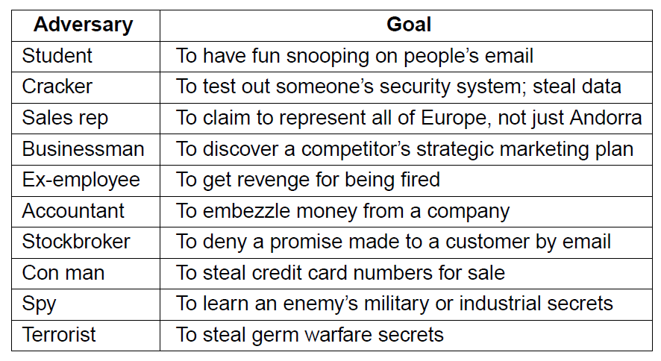
Network Security…
Different adversaries and security threats;
  Different threats require different defenses
Table 1-1: Adversaries & Threats

Slide 6
Network Security
  Cryptography
  Symmetric-Key Algorithms
  Public-Key Algorithms
  Digital Signatures
  Management of Public Keys
  Communication Security
  Authentication Protocols
  Email Security
  Web Security
  Social Issues

Slide 7
Cryptography
Cryptography is a fundamental building block for security mechanisms;
  Introduction
  Substitution ciphers
  Transposition ciphers
  One-time pads
  Fundamental cryptographic principles

Slide 8
Introduction: Kerckhoff’s Principle
Stated by Auguste Kerckhoffs in the 19th century.
A cryptosystem should be secure even if everything about the system, except the key, is public knowledge.
Reformulated by Claude Shannon as "the enemy knows the system" i.e. "one ought to design systems under the assumption that the enemy will immediately gain full familiarity with them".
In that form, it is called Shannon's maxim. In contrast to "security through obscurity", it is widely embraced by cryptographers.

Slide 9
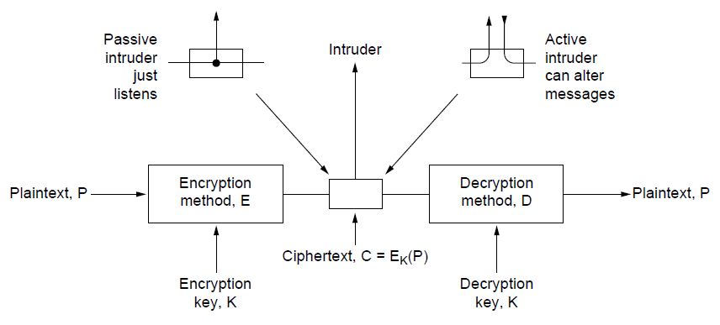
Kerckhoff’s Principle…
The encryption model (for a symmetric-key cipher);
  Kerckhoff’s principle: Algorithms (E, D) are public; only the keys (K) are secret.
Trudy
Alice
Bob
Figure 1-1: Kerckhoff’s Principle

Slide 10
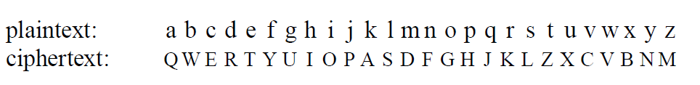
Substitution Ciphers
Substitution ciphers replace each group of letters in the message with another group of letters to disguise it;
Simple single-letter substitution cipher
Figure 1-2: Substitution Ciphers

Slide 11
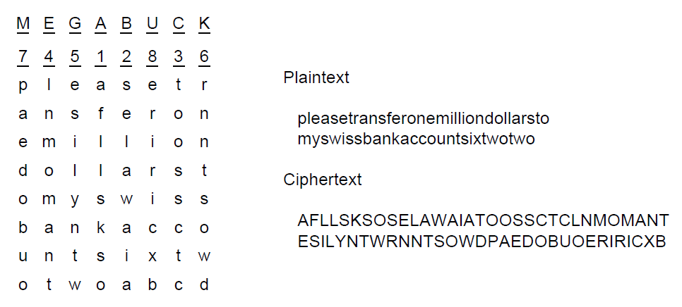
Transposition Ciphers
Transposition ciphers reorder letters to disguise them;
Key gives column order
Column 5
6
7
8
Simple column transposition cipher
Figure 1-3: Transposition Ciphers

Slide 12
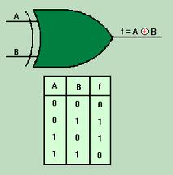
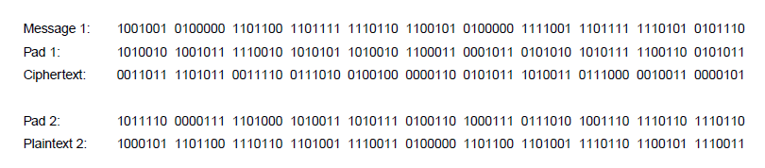
One-Time Pads
Simple scheme for perfect secrecy;
  XOR message with secret pad to encrypt, decrypt
  Pad is as long as the message and can’t be reused!
    It is a “one-time” pad to guarantee secrecy.
Different secret pad decrypts to the wrong plaintext
Figure 1-4: One-Time Pads

Slide 13
Fundamental Cryptographic Principles
Messages must contain some redundancy i.e. information not needed to understand the message;
  All encrypted messages decrypt to something
  Redundancy lets receiver recognize a valid message
  But redundancy helps attackers break the design.
Some method is needed to foil replay attacks;
  Without a way to check if messages are fresh then old messages can be copied and resent.
  For example, add a date stamp to messages.

Slide 14
Network Security
  Cryptography
  Symmetric-Key Algorithms
  Public-Key Algorithms
  Digital Signatures
  Management of Public Keys
  Communication Security
  Authentication Protocols
  Email Security
  Web Security
  Social Issues

Slide 15
Symmetric-Key Algorithms
Encryption in which the parties share a secret key;
  DES – Data Encryption Standard
  AES – Advanced Encryption Standard
  Cipher modes
  Other ciphers

Slide 16
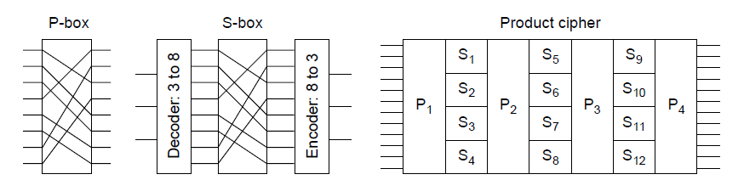
Symmetric-Key Algorithms
Use the same secret key to encrypt and decrypt; block ciphers operate a block at a time;
  Product cipher combines transpositions/substitutions
Permutation
(transposition)
box
Substitution
box
Product with multiple P- and S-boxes
Figure 1-5: Symmetric-Key Algorithms

Slide 17
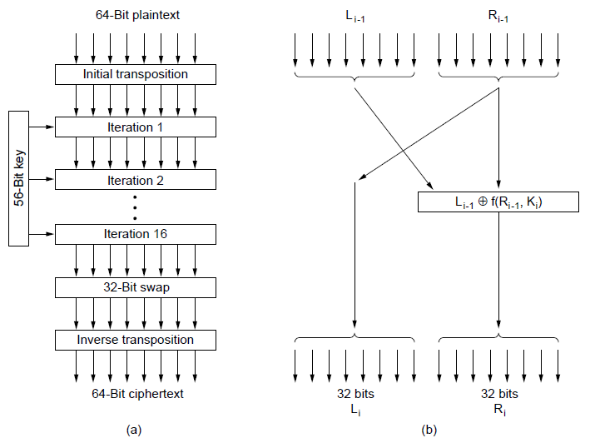
Data Encryption Standard
DES encryption was widely used (but no longer secure);
Contains
transpositions & substitutions
DES steps
A single iteration
Figure 1-6: DES

Slide 18
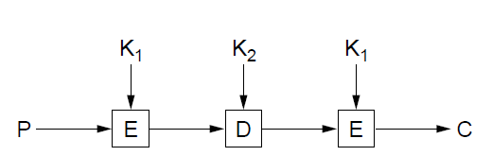
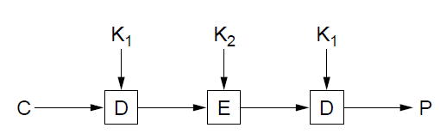
Data Encryption Standard…
Triple encryption (“3DES”) with two 56-bit keys;
  Gives an adequate key strength of 112 bits
  Setting K₁ = K₂ allows for compatibility with DES
Triple DES encryption
Triple DES decryption
Figure 1-7: 3DES

Slide 19
Advanced Encryption Standard
AES is the successor to DES;
  Symmetric block cipher, key lengths up to 256 bits
  Openly designed by public competition (1997-2000)
  Available for use by everyone
  Built as software (e.g. C) or hardware (e.g. x86)
  Winner was Rijndael cipher – Joan Daemen & Vincent Rijmen
  Now a widely used standard

Slide 20
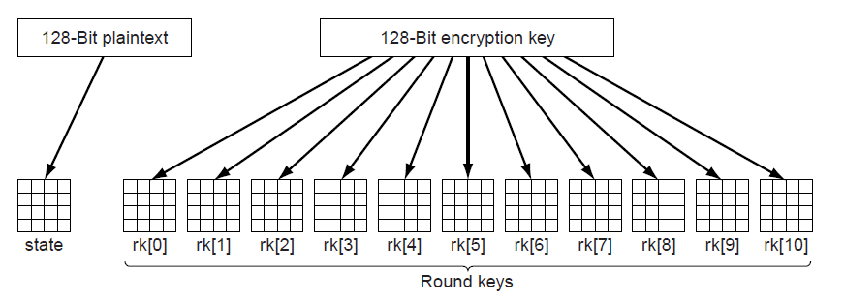
Advanced Encryption Standard…
AES uses 10 rounds for 128-bit block and 128-bit key;
  Each round uses a key derived from 128-bit key
  Each round has a mix of substitutions and rotations
  All steps are reversible to allow for decryption.
Round keys are derived from 128-bit secret key
Figure 1-8: AES

Slide 21
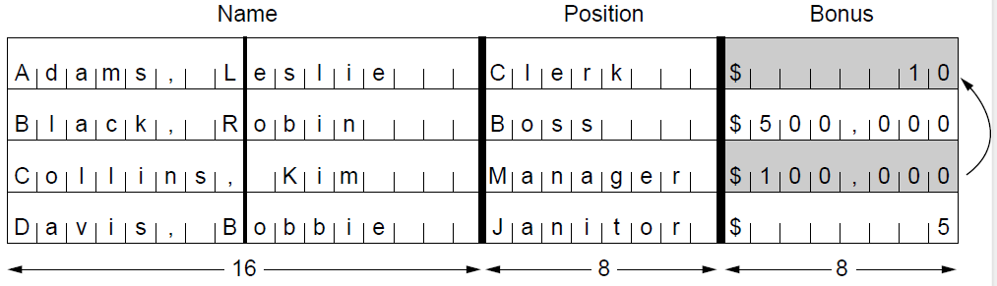
Cipher Modes
Cipher modes set how long messages are encrypted;
  Encrypting each block independently, called ECB (Electronic Code Book) mode, is vulnerable to shifts.
With ECB mode, switching encrypted blocks gives a different but valid message
Leslie gets a large bonus!
Figure 1-9: Cipher Modes

Slide 22
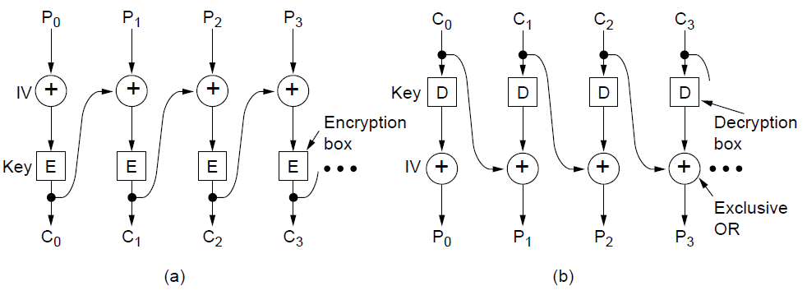
Cipher Modes…
Cipher Block Chaining (CBC) is a widely used mode;
  Chains blocks together with XOR to prevent shifts
  Has a random IV (Initial Value) for different output.
CBC mode encryption
CBC mode decryption
Figure 1-10: CBC
Notes:
Because of the IV, repeated encryptions of the same message will produce different ciphertext.

Slide 23
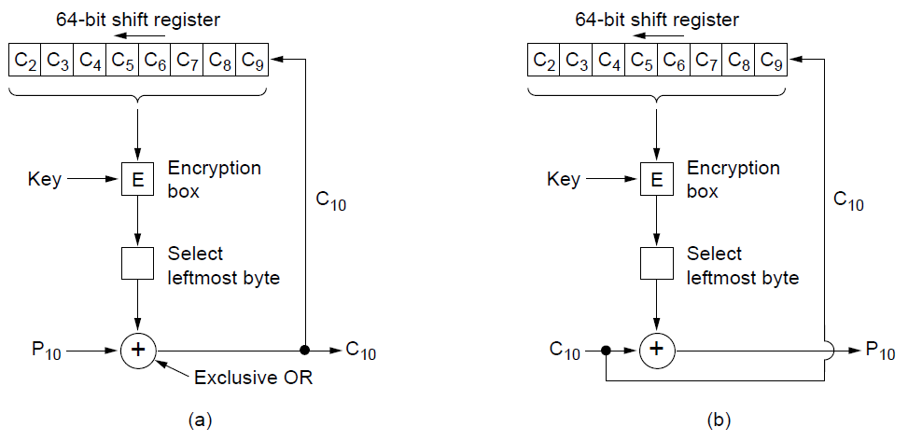
Cipher Modes…
There are many other modes with pros / cons e.g. cipher feedback mode is similar to CBC mode but can operate a byte (rather than a whole block) at a time;
Encryption
Decryption
Figure 1-11: Cipher Modes

Slide 24
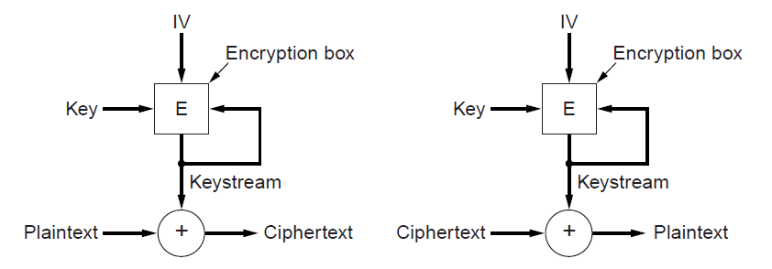
Cipher Modes…
A stream cipher uses the key and IV to generate a stream that is a one-time pad; can’t reuse (key, IV) pair;
  Doesn’t amplify transmission errors like CBC mode.
Encryption
Decryption
Figure 1-12: Stream Cipher

Slide 25
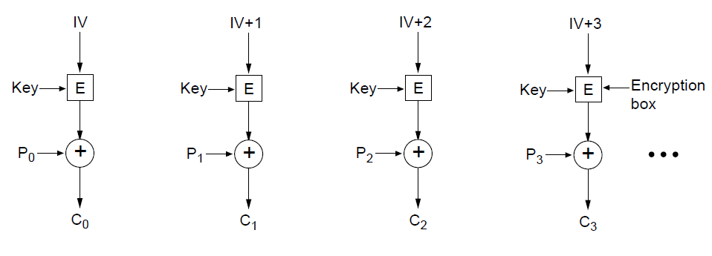
Cipher Modes…
Counter mode (encrypt a counter and XOR it with each message block) allows random access for decryption;
Encryption above; repeat the operation to decrypt
Figure 1-13: Counter Mode

Slide 26
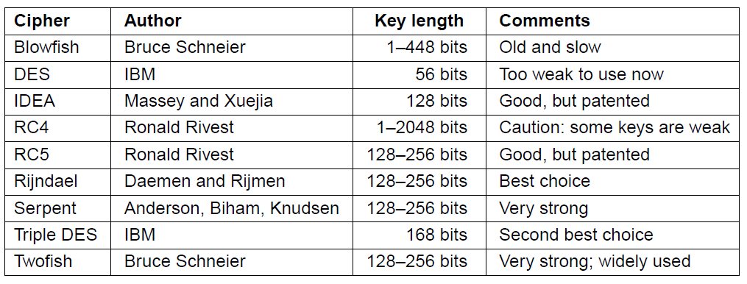
Other Ciphers
Some common symmetric-key cryptographic algorithms
  Can be used in combination e.g. AES over Twofish
Table 1-1: Other Ciphers

Slide 27
Network Security
  Cryptography
  Symmetric-Key Algorithms
  Public-Key Algorithms
  Digital Signatures
  Management of Public Keys
  Communication Security
  Authentication Protocols
  Email Security
  Web Security
  Social Issues

Slide 28
Public-Key Algorithms
  Encryption in which each party publishes a public part of their key and keep secret a private part of it;
  RSA (by Rivest, Shamir, Adleman) - 1977

Slide 29
Public-Key Algorithms…
Downsides of keys for symmetric-key designs;
  Key must be secret, yet be distributed to both parties
  For N users there are N² pairwise keys to manage.
Public key schemes split the key into public and private parts that are mathematically related;
  Private part is not distributed; easy to keep secret
  Only one public key per user needs to be managed.
Security depends on the chosen mathematical property;
  Much slower than symmetric-key, e.g. 1000X
  So used to set up per-session symmetric keys.

Slide 30
RSA
RSA is a widely used public-key encryption method whose security is based on the difficulty of factoring large numbers;
  Key generation:
    Choose two large primes, p and q
    Compute n = p × q and z = ( p − 1) × (q − 1).
    Choose d to be relatively prime to z
    Find e such that e × d = 1 mod z
    Public key is (e, n), and private key is (d, n)
Encryption (of k bit message, for numbers up to n):
  Cipher = Plain^{e} (mod n)
Decryption:
  Plain = Cipher^{d} (mod n)

Slide 31
RSA…
Modulus Operator: %
  Often used in the form a mod b
  E.g. 4 mod 3
  Also used as shorthand in programming
  Returns the remainder when the first number is divided by the second
  1 mod 3 = 1 or 1%3 = 1; 2 mod 3 = 2
  3 mod 3 = 0; 4 mod 3 = 1
  5 mod 3 = 2; 6 mod 3 = 0
  Powerful tool for mathematicians especially specialists in Number Theory.

Slide 32
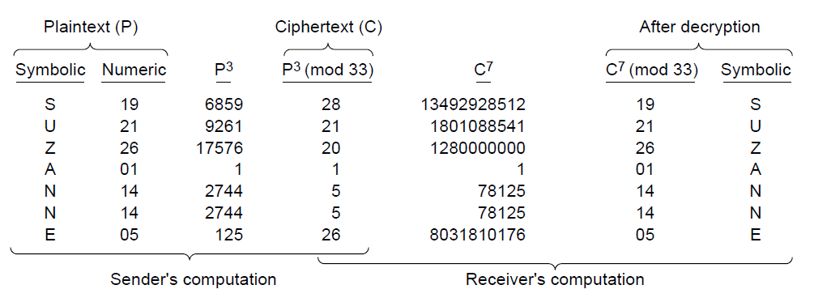
RSA…
Small-scale example of RSA encryption;
  For p=3, q=11 → n=33 i.e. p x q, z=20 i.e. ( p − 1) × (q − 1). → d=7, e=3
Encryption: C = P³ mod 33
Decryption: P = C⁷ mod 33
Figure 1-14: Sample RSA Encryption

Slide 33
Network Security
  Cryptography
  Symmetric-Key Algorithms
  Public-Key Algorithms
  Digital Signatures
  Management of Public Keys
  Communication Security
  Authentication Protocols
  Email Security
  Web Security
  Social Issues

Slide 34
Digital Signatures
Lets receiver verify whether or not the message is authentic;
  Symmetric-Key signatures
  Public-Key signatures
  Message digests
  The birthday attack

Slide 35
Digital Signatures…
Requirements for a signature;
  Receiver can verify claimed identity of sender.
  Sender cannot later repudiate (reject) contents of message.
  Receiver cannot have concocted message himself.

Slide 36
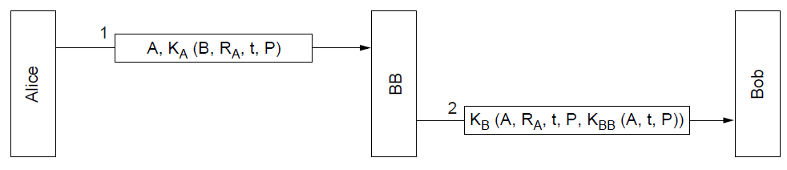
Symmetric-Key Signatures
Alice and Bob each trust and share a key with Big Brother; Big Brother doesn’t trust anyone;
  A=Alice, B=Bob, P=message, R_{A}=random, t=time
Only Alice can send this encrypted message to BB
Only BB can send this encrypted message to Bob
Figure 1-15: Symmetric Key Signatures
Notes:
RA and time protect against replays. Time lets very old messages be detected. For recent messages, RA can be checked to see if it has been used before.

Slide 37
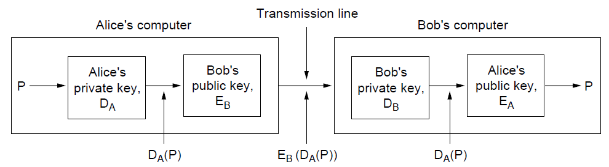
Public-Key Signatures
No Big Brother and assumes encryption and decryption are inverses that can be applied in either order;
  But relies on private key kept and secret.
  RSA & DSS (Digital Signature Standard) widely used
Figure 1-16: Public Key Signatures

Slide 38
Message Digests
Message Digest (MD) converts an arbitrary-sized message (P) into a fixed-size identifier MD(P) with properties;
  Given P, its easy to compute MD(P).
  Given MD(P), its effectively impossible to find P.
  Given P no one can find P′ so that MD(P′) = MD(P).
  Changing 1 bit of P produces very different MD.
Message digests (also called cryptographic hash) can “stand for” messages in protocols, e.g. authentication;
  Example: SHA-1 160-bit hash, widely used
  Example: MD5 128-bit hash – now known broken.

Slide 39
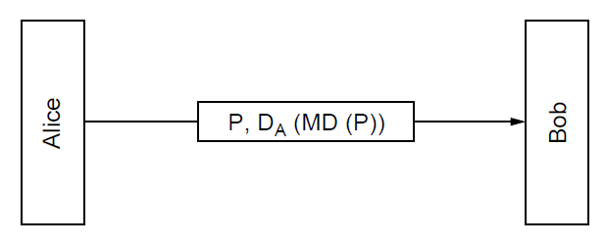
Message Digests…
Public-Key signature for message authenticity but no confidentiality with a message digest;
Message sent in the clear
Alice signs
message digest
Figure 1-17: Message Digests

Slide 40
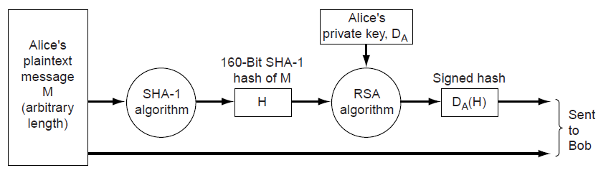
Message Digests…
In more detail: example of using SHA-1 message digest and RSA public key for signing non secret messages;
Figure 1-18: SHA-1 & RSA

Slide 41
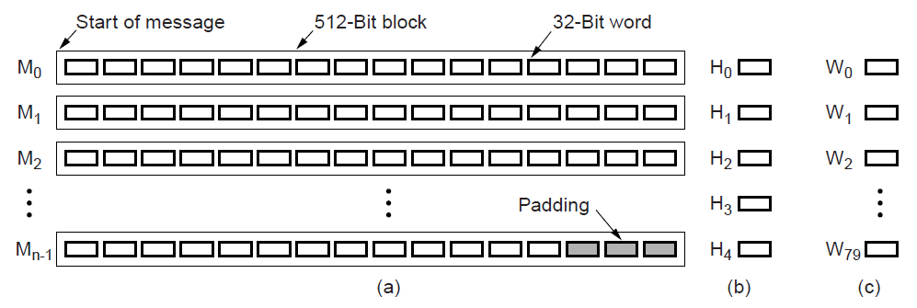
Message Digests…
SHA-1 digests the message 512 bits at a time to build a 160-bit hash as five 32-bit components;
SHA-1
Message in 512-bit blocks
Five 32-bit hashes output
Figure 1-19: SHA-1

Slide 42
Birthday Attack…
A statistical phenomenon relevant to info. security that makes the brute forcing of 1-way hashes easier;
  Based on the birthday paradox, which states; in order for there to be a 50% chance that someone in a given room shares your birthday, you need 253 people in the room.
  If, however, you are looking for a greater than 50% chance that any two people in the room have the same birthday, you only need 23 people.

Slide 43
Birthday Attack…
  Why? Because the matches are based on pairs. If I choose myself as one side of the pair, then I need a full 253 people to get to the magic number of 253 pairs. In other words, it’s me combined with 253 other people to make up all 253 sets.
  This applies to finding collisions in hashing algorithms because it's much harder to find something that collides with a given hash than it is to find any two inputs that hash to the same value.

Slide 44
Birthday Attack
How hard is it to find a message P′ that has the same message digest as P?
  Such a collision will allow P′ to be substituted for P!
  Analysis:
  N bit hash has 2^{N} possible values.
  Expect to test 2^{N} messages given P to find P′.
  But expect only 2^{N/2} messages to find a collision.
  This is the Birthday Attack.

Slide 45
Network Security
  Cryptography
  Symmetric-Key Algorithms
  Public-Key Algorithms
  Digital Signatures
  Management of Public Keys
  Communication Security
  Authentication Protocols
  Email Security
  Web Security
  Social Issues

Slide 46
Management of Public Keys
We need a trusted way to distribute public keys;
  Certificates
  X.509, the certificate standard
  Public Key Infrastructures

Slide 47
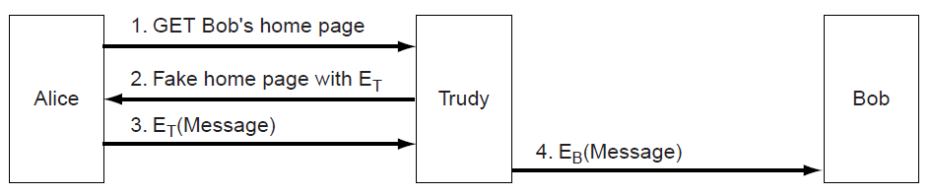
Management of Public Keys…
Trudy can subvert (undermine) encryption if she can fake Bob’s public key; Alice and Bob will not necessarily know;
Trudy replaces E_{B} with E_{T} and acts as a “man in the middle”
Figure 1-20: Subverting Encryption

Slide 48
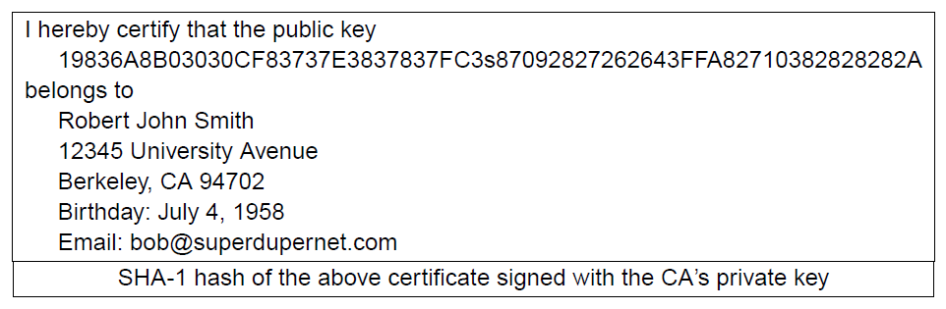
Certificates
Certification Authority (CA) issues signed statements about public keys; users trust CA and it can be offline;
A possible certificate
Figure 1-21: Certificates

Slide 49
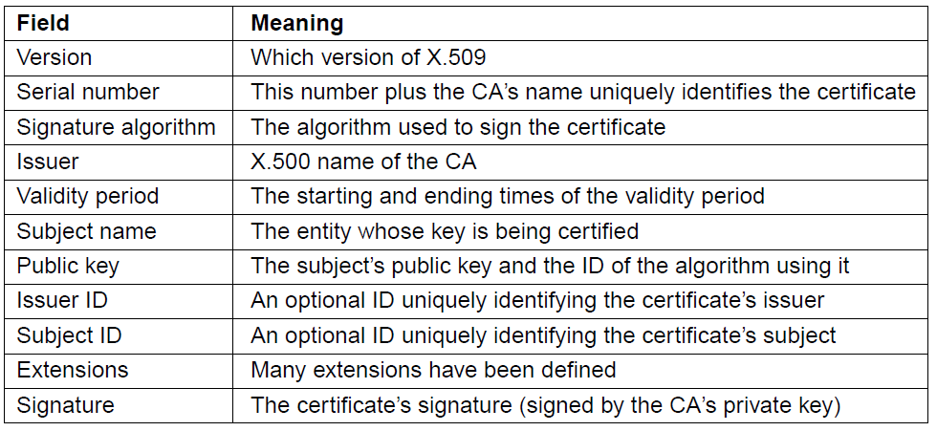
X.509
X.509 is the standard for widely used certificates;
  E.g.: used with SSL for secure Web browsing.
Basic fields in X.509 certificates
Table 1-2: X.509 Certificates

Slide 50
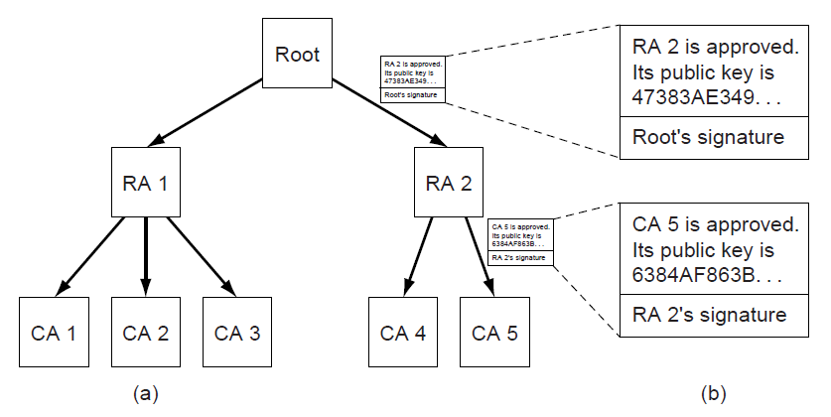
Public Key Infrastructures (PKIs)
PKI is a system for managing public keys using CAs;
  Scales with hierarchy, may have multiple roots.
  Also need CRLs (Certificate Revocation Lists).
Trust anchor
Chain of certificates for CA 5
Hierarchical PKI
Figure 1-22: PKIs

Slide 51
Network Security
  Cryptography
  Symmetric-Key Algorithms
  Public-Key Algorithms
  Digital Signatures
  Management of Public Keys
  Communication Security
  Authentication Protocols
  Email Security
  Web Security
  Social Issues

Slide 52
Communication Security
Applications of security to network protocols;
  IPsec (IP security)
  Firewalls
  Virtual private networks
  Wireless security

Slide 53
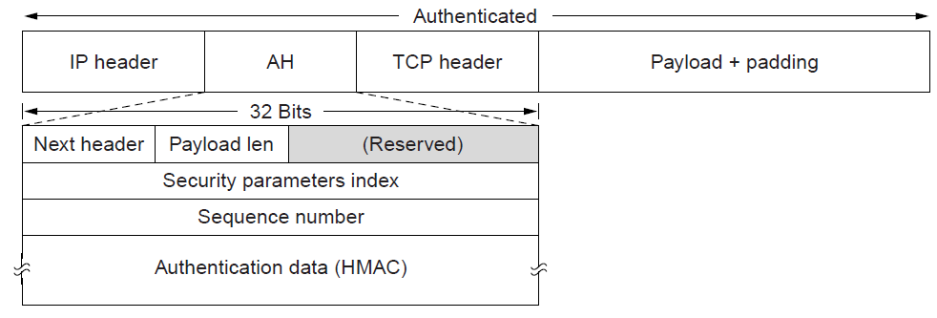
IPsec
IPsec adds confidentiality and authentication to IP;
  Secret keys are set up for packets between endpoints called security associations.
  Adds AH header; inserted after IP in transport mode.
Identifies security association
HMAC - Hashed Message Authentication Code
AH (Authentication Header) provides integrity and anti-replay
Figure 1-23: IPsec

Slide 54
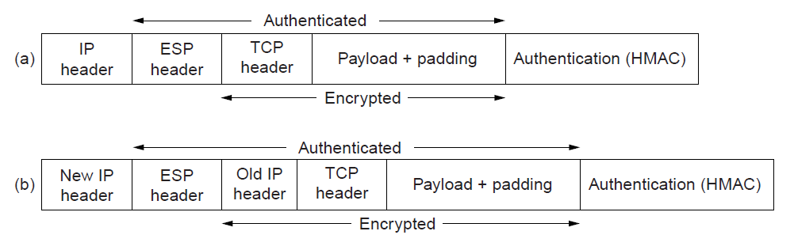
IPsec…
Encapsulating Security Payload (ESP) provides secrecy and integrity; expands on AH;
  Adds ESP header and trailer; inserted after IP header in transport (client-to-site VPN) or before in tunnel mode (site-to-site- less MSS)..
Transport mode
Tunnel mode
Whole IP packet is wrapped
Figure 1-24: ESP

Slide 55
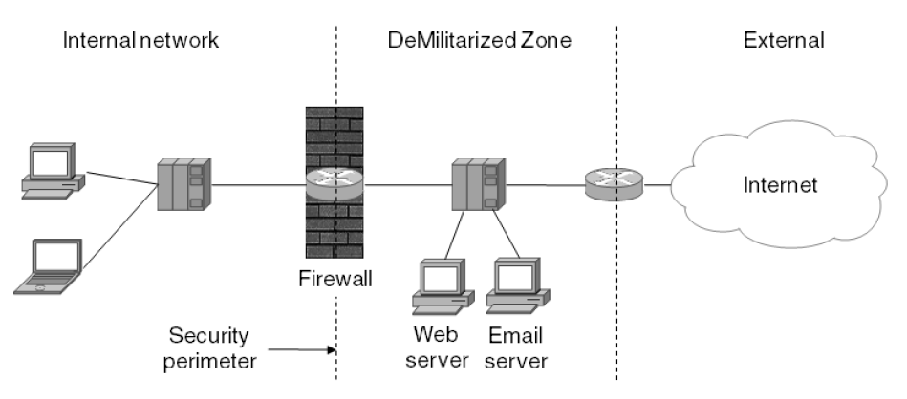
Firewalls
A firewall protects an internal network by filtering packets;
  Can have stateful rules about what packets to pass;
    E.g. no incoming packets to port 80 (Web) or 25 (SMTP)
  DMZ helps to separate internal from external traffic.
    E.g. run Web and Email servers there.
DMZ
Figure 1-25: Firewall

Slide 56
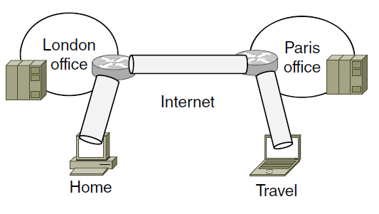
Virtual Private Networks
Virtual Private Networks (VPNs) join disconnected islands of a logical network into a single virtual network;
  Islands are joined by tunnels over the Internet.
Tunnel
VPN joining London, Paris, Home, and Travel
Figure 1-26: VPNs

Slide 57
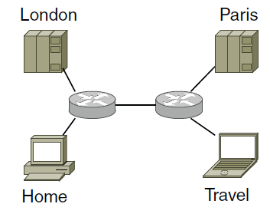
Virtual Private Networks…
VPN traffic travels over the Internet but VPN hosts are separated from the Internet;
  Need a gateway to send traffic in/out of VPN.
Topology as seen from inside the VPN
Figure 1-27: VPNs

Slide 58
Wireless Security
Wireless signals are broadcast to all nearby receivers;
  Important to use encryption to secure the network
  This is an issue for 802.11, Bluetooth, 3G, …
Common design:
  Clients have a password set up for access
  Clients authenticate to infrastructure and set up a session key.
  Session key is then used to encrypt packets.

Slide 59
Wireless Security….
802.11i: a standard for wireless local area networks (WLANs) that provides improved encryption for networks that use 802.11a (54Mbps), 802.11b (11 Mbps) (including Wi-Fi) and 802.11g (54Mbps) WLAN standards.
  requires new encryption key protocols, known as Temporal Key Integrity Protocol (TKIP) and AES.
  officially ratified by IEEE in June 2004, and thereby became part of the 802.11 family of wireless network specifications.
Nonce: an arbitrary number used only once in a cryptographic communication.

Slide 60
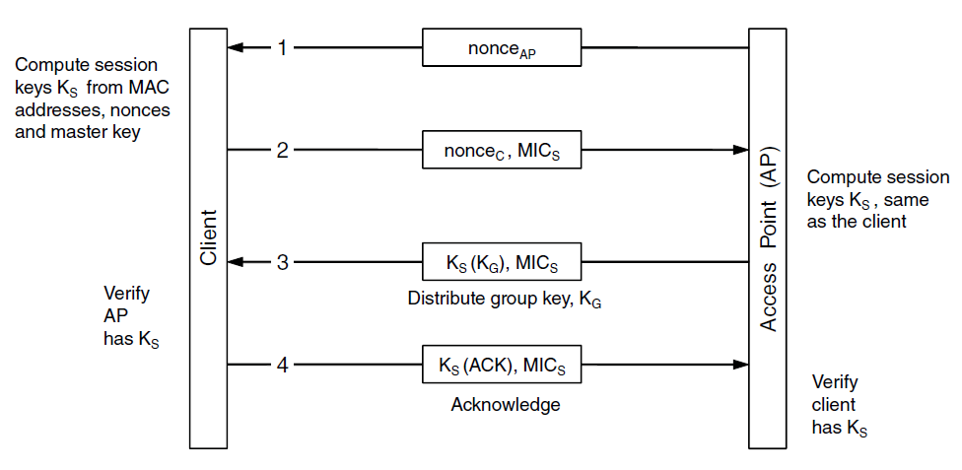
Wireless Security…
802.11i session key sets up handshake (step 2);
    Client and AP share a master key (password)
    MIC (Message Integrity Check) is like a signature
    K_{X}(M) means a message M encrypted with key K_{X}
Figure 1-28: Wireless Security

Slide 61
Network Security
  Cryptography
  Symmetric-Key Algorithms
  Public-Key Algorithms
  Digital Signatures
  Management of Public Keys
  Communication Security
  Authentication Protocols
  Email Security
  Web Security
  Social Issues

Slide 62
Authentication Protocols
Authentication verifies the identity of a remote party;
  Shared Secret Key
  Diffie-Hellman Key Exchange
  Key Distribution Center
  Kerberos
  Public-Key Cryptography

Slide 63
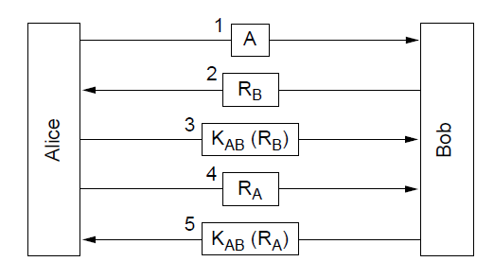
Shared Secret Key
Authenticating with a challenge-response (first attempt);
  Alice (A) and Bob (B) share a key K_{AB}
  R_{X} is random, K_{X} (M) is M encrypted with key K_{X}
Challenge
Response
Bob knows it’s Alice
Alice knows it’s Bob
Figure 1-29: Shared Secret Key Authentication

Slide 64
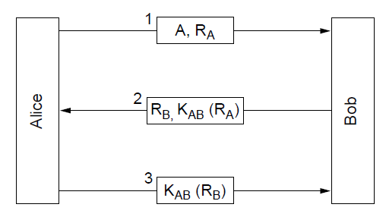
Shared Secret Key…
A shortened two-way authentication (second attempt);
  But it is vulnerable to reflection attack
Figure 1-30: Shared Secret Key

Slide 65
Shared Secret Key…
Reflection Attack: E.g. a military implements system that allows them to tell immediately if an aircraft on their radar is a good guy or a bad guy (referred to as Identify Friend from Foe (IFF) system).
  1. Alice > Bob: n ← Challenge
  2. Bob > Alice: E(K,n) ← Response where: n is a unique random nonce, K is a pre-shared Key, E is a suitable encryption/derivation fn.
  Enemy aircraft defeats the system by reflecting the challenge to some other member of the good guys team.

Slide 66
Shared Secret Key…
  1. Alice > Bob: n ← Challenge
  2. Bob > Charlie: n ← Reflection Attack
  3. Charlie > Bob: E(K,n) ← Bob receives correct response to Alice’s Challenge
  4. Bob ← Alice: E(K,n) ← & authenticates himself to Alice
  Enemy aircraft defeats the system by reflecting the challenge to some other member of the good guys team.
  At the 4th step, Bob authenticates himself to Alice who lets him fly past. Bob did this without knowledge of K by sending the challenge to a member of the good guys team – Charlie who knows value of K and can generate the correct response.

Slide 67
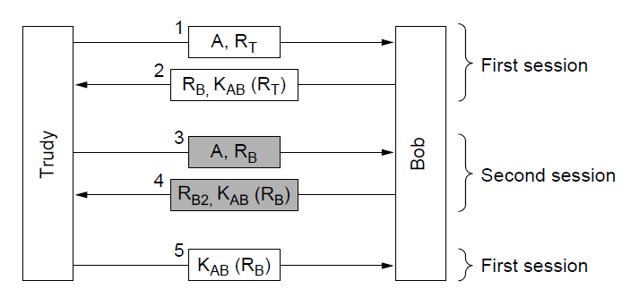
Shared Secret Key…
Trudy impersonates Alice to Bob with reflection attack;
  Second session gets Bob to give Trudy the response.
Bob thinks he is talking to Alice now
Figure 1-31: Shared Secret Key

Slide 68
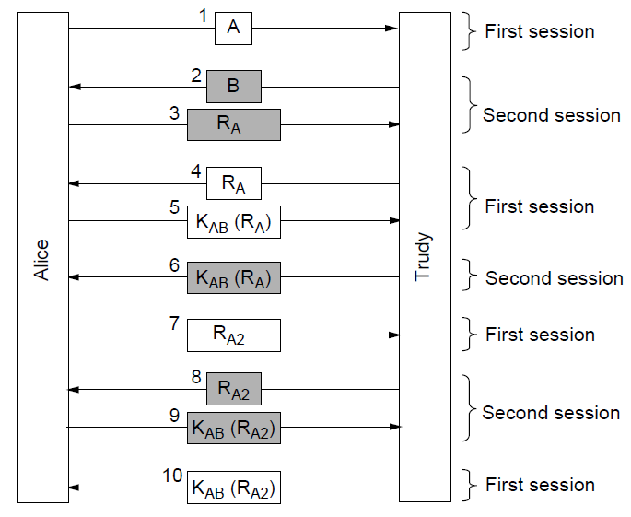
Shared Secret Key…
First attempt is also vulnerable to reflection attack!
  Trudy impersonates Bob to Alice after Alice initiates
Alice thinks she is talking to Bob
Alice thinks she is talking to Bob again
Figure 1-32: Shared Secret Key

Slide 69
Shared Secret Key…
Moral: Designing a correct authentication protocol is harder than it looks; errors are often subtle;
General design rules for authentication:
  Have initiator prove who she is before responder
  Initiator, responder use different keys
  Draw challenges from different sets
  Make protocol resistant to attacks involving second parallel session.

Slide 70
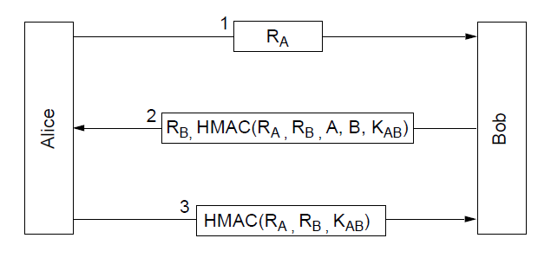
Shared Secret Key…
An authentication protocol that is not vulnerable;
  Hashed Message Authentication Code (HMAC) is an authenticator, like a signature.
Alice knows it’s Bob
Bob knows it’s Alice
Figure 1-33: HMAC

Slide 71
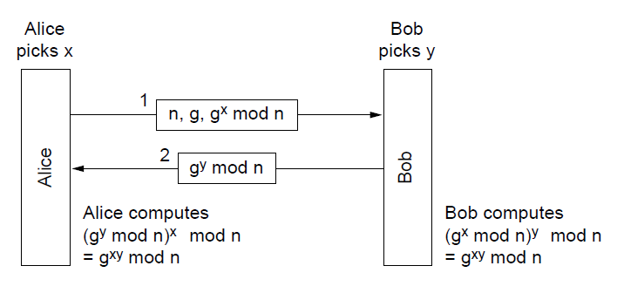
Diffie-Hellman Key Exchange
Lets two parties establish a shared secret;
  Eavesdropper can’t compute secret g^{xy} mod n without knowing x or y
  n: unique random nonce
  x: random number picked by Alice
  y: random number picked by Bob.
Shared secret
Shared secret
Figure 1-34: Diffie-Hellman Key Exchange

Slide 72
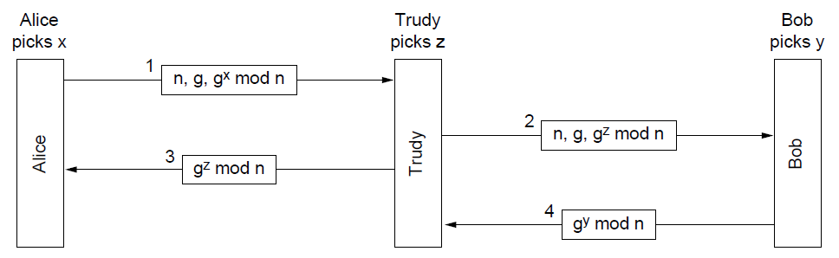
Diffie-Hellman Key Exchange…
But it is vulnerable to a man-in-the-middle attack;
  Need to confirm identities, not just share a secret;
g^{xz} mod n
g^{xz} mod n
g^{zy} mod n
g^{zy} mod n
Figure 1-35: Deffie-Hellman Key Exchange

Slide 73
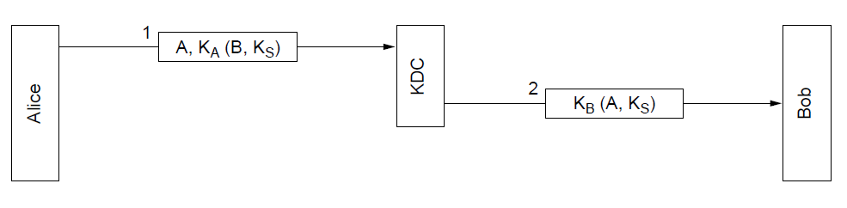
Key Distribution Center (KDC)
Trusted KDC removes need for many shared secrets;
  Alice and Bob share a secret only with KDC (K_{A}, K_{B})
  End up with K_{S}, a shared secret session key
  First attempt below is vulnerable to replay attack in which Trudy captures and later replays messages.
Trudy can send this later to impersonate Alice to Bob
Bob has session key K_{S}
Alice has session key K_{S}
Figure 1-36: KDC

Slide 74
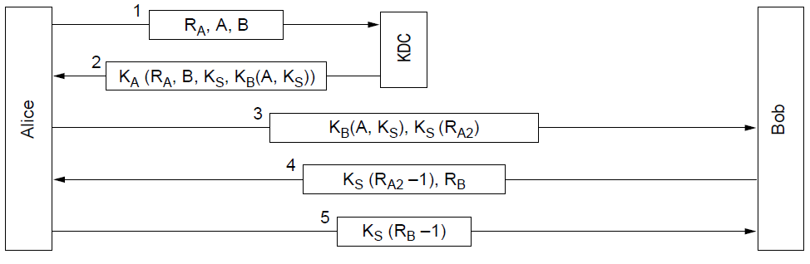
Key Distribution Center…
The Needham-Schroeder authentication protocol;
  Not vulnerable to replays; doesn’t use timestamps.
Alice knows it’s Bob
Bob knows it’s Alice
Figure 1-37: Needham-Schroeder Auth. Protocol

Slide 75
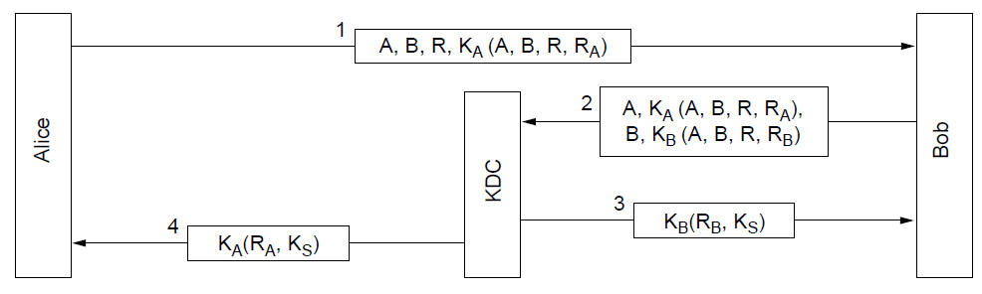
Key Distribution Center…
The Otway-Rees authentication protocol (simplified);
  Slightly stronger than previous; Trudy can’t replay even if she obtains previous secret K_{S}
Figure 1-38: Otway-Rees Auth. Protocol

Slide 76
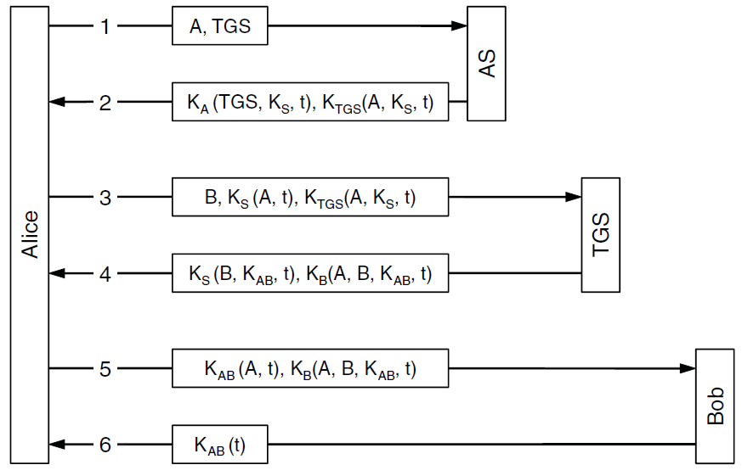
Kerberos
Kerberos V5 is a widely used protocol (e.g. Windows)
  Authentication includes a Ticket Granting Server (TGS).
Ticket
Gets session key K_{S}
Alice asks for a secret shared with Bob
Ticket
Gets shared key K_{AB}
Knows it’s Alice
Bob gets key K_{AB}
Knows it’s Bob
Figure 1-39: Kerberos
Notes:
The timestamps, t, are used to weed out very old messages

Slide 77
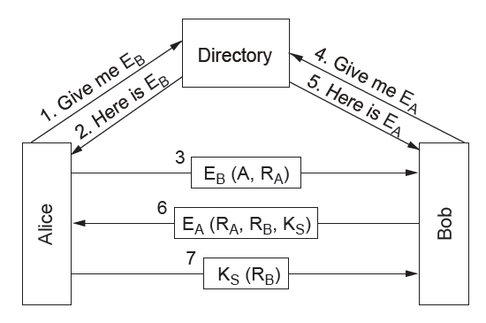
Public-Key Cryptography
Mutual authentication using public-key cryptography;
  Alice and Bob get each other’s public keys (E_{A}, E_{B}) from a trusted directory; shared K_{S} is the result.
Figure 1-40: Public-Key Cryptography

Slide 78
Network Security
  Cryptography
  Symmetric-Key Algorithms
  Public-Key Algorithms
  Digital Signatures
  Management of Public Keys
  Communication Security
  Authentication Protocols
  Email Security
  Web Security
  Social Issues

Slide 79
Email Security
Use of security for authenticated, confidential email;
  PGP - Pretty Good Privacy

Slide 80
PGP - Pretty Good Privacy
PGP uses public and symmetric-key cryptography for email secrecy and signatures; it also manages keys;
Levels of public-key strengths:
  Casual (384 bits):
    Can be broken easily today.
  Commercial (512 bits):
    Breakable by three-letter organizations.
  Military (1024 bits):
    Not breakable by anyone on earth.
  Alien (2048 bits):
    Unbreakable by anyone on other planets

Slide 81
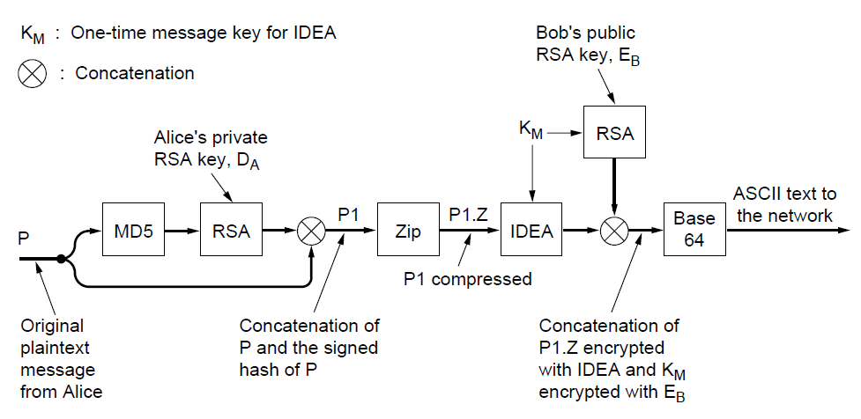
PGP - Pretty Good Privacy…
Signing and encrypting a message from Alice to Bob;
  For speed, message symmetric-key IDEA encrypted with K_{M}; K_{M} is RSA public-key encrypted with K_{B}
IDEA: Intern. Data Encryption Algorithm
Authentication
Confidentiality
Figure 1-41: PGP

Slide 82
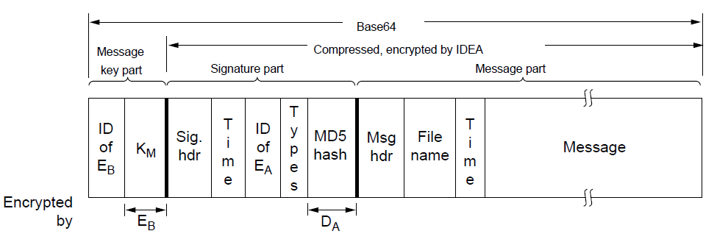
PGP - Pretty Good Privacy…
Three parts of a PGP message and their encryption:
PGP also manages public keys for a user:
  Private key ring has user’s public/private keys
  Public key ring has correspondent’s public keys
K_{M}
Figure 1-43: PGP

Slide 83
Network Security
  Cryptography
  Symmetric-Key Algorithms
  Public-Key Algorithms
  Digital Signatures
  Management of Public Keys
  Communication Security
  Authentication Protocols
  Email Security
  Web Security
  Social Issues

Slide 84
Web Security
Applications of security to the Web;
  Secure naming
  SSL - Secure Sockets Layer
Many other issues with downloaded code;

Slide 85
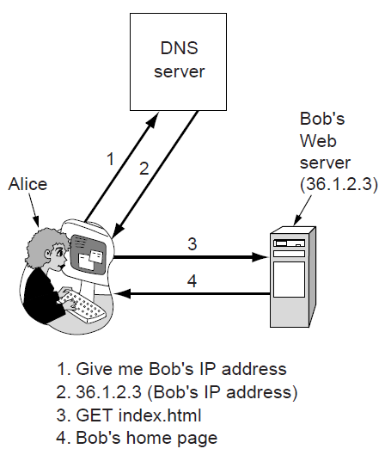
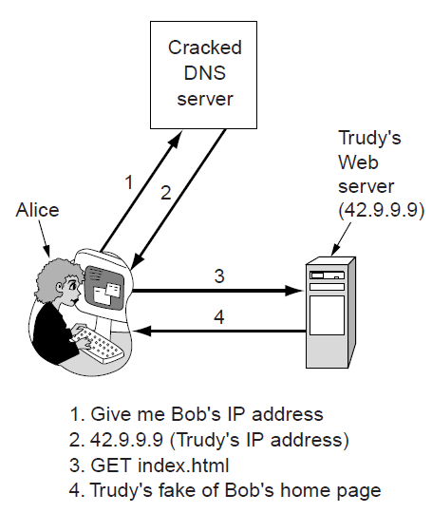
Secure Naming
DNS names are included as part of URLs – so spoofing DNS resolution causes Alice to contact Trudy not Bob
Trudy sends spoofed reply
Figure 1-42: Secure Naming

Slide 86
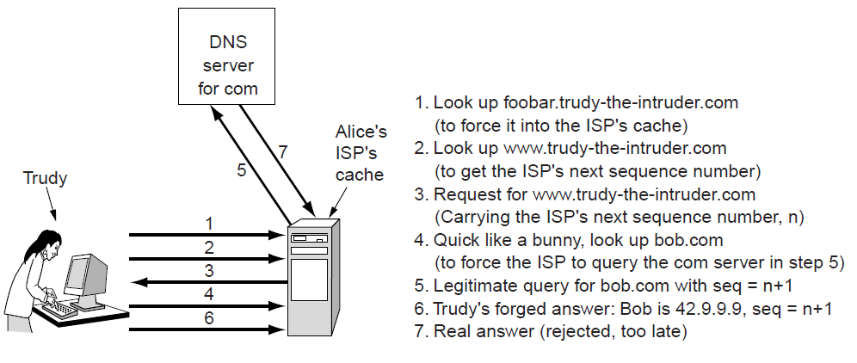
Secure Naming…
How Trudy spoofs the DNS for bob.com in more detail;
  To counter, DNS servers randomize seq. numbers
DNS cache at Alice’s ISP
Figure 1-43: Secure Naming

Slide 87

Secure Naming…
DNSsec (DNS security) adds strong authenticity to DNS;
  Responses are signed with public keys
  Public keys are included; client starts with top-level
  Also optional anti-spoofing to tie request/response
  Now being deployed in the Internet
Resource Record set for bob.com.
Has Bob’s public key (KEY), and is signed by .com server (SIG)
Table 1-3: DNSsec
Notes:
Bob’s public key can be used in the future to check the authenticity of responses for machines within bob.com.

Slide 88

SSL - Secure Sockets Layer
SSL provides an authenticated, secret connection between two sockets; uses public keys with X.509;
  TLS (Transport Layer Security) is the IETF version.
SSL runs on top of TCP and below
the application
HTTPS means
HTTP over SSL
SSL in the protocol stack
Figure 1-44: SSL

Slide 89

SSL - Secure Sockets Layer…
Phases in SSL V3 connection establishment (simplified);
  Only the client (Alice) authenticates the server (Bob)
  Session key computed on both sides (E_{B}, R_{A}, R_{B}).
Figure 1-45: SSL Phases

Slide 90

SSL - Secure Sockets Layer…
Data transmission using SSL. Authentication and encryption for a connection use the session key.
Figure 1-46: SSL Data Transmission

Slide 91
Network Security
  Cryptography
  Symmetric-Key Algorithms
  Public-Key Algorithms
  Digital Signatures
  Management of Public Keys
  Communication Security
  Authentication Protocols
  Email Security
  Web Security
  Social Issues

Slide 92
Social Issues
Networks give rise to many social issues;
  Privacy
  Freedom of speech

Slide 93

Privacy
Anonymous remailers hide the identity of the sender;
  Unlike PGP, which only hides message contents.
  A chain can be used for stronger anonymity.
Alice looks up keys E1, E2, E3 separately
Bob gets a very anonymous mail
Figure 1-47: Chain

Slide 94

Freedom of Speech
Steganography hides messages on unrelated content;
  Can help avoid censorship or protect ownership.
Text hidden in low-order bits
“Three zebras and a tree”
“Three zebras and a tree,” with five plays by Shakespeare”
Figure 1-48: Steganography

Slide 95
Trivia – Tanenbaum 5th Ed Chapter 1
An alternative to a LAN is simply a BIG timesharing system with terminals for all users. Give two advantages of a client-server system using a LAN.
Besides bandwidth and latency, what other parameter is needed to give a good characterization of the QoS offered by a network used for;
  digitized voice traffic?
  video traffic?
  Financial transaction traffic?

Slide 96
Trivia – Tanenbaum 5th Ed Chapter 1…
A client-server system uses a satellite network, with the satellite at a height of 40,000 km. What is the best-case delay in response to a request?
PS. The speed of light & air in vacuum is 300,000
km/sec.
What are two reasons for using layered protocols? What is one possible disadvantage of using layered protocols.

Slide 97
Trivia – Tanenbaum 5th Ed Chapter 1…
The president of Imara Corp. gets the idea to work with a local beer brewer to produce an invisible beer can (as an anti-litter measure). The president tells her legal dept. to look into it, and they in turn ask engineering for help. As a result, the chief engineer calls his counterpart at the brewery to discuss the technical aspects of the project.
The engineers the report back to their respective legal depts., which then confer by phone to plan legal aspects. Finally the two corporate presidents discuss the financial side of the deal. What principle of a multilayer protocol in the sense of the OSI model does this communication mechanism violate?

Slide 98
Recommended Reading
  http://www.cs.ucsb.edu/~almeroth/classes/W10.290F/papers/compare.pdf

Slide 99
Next Week……
Fault Tolerance

